Slide 1






Smart Digital Identity Theft Detection System
Using Behavioral Patterns
A Bachelor of Computer Application Synopsis
Presented by:
SONIKA M K: U01CO23S0402
ARUN PRASAD M: U01CO23S0403
SNEHA K K: U01CO23S0405
CHAITHRA K S: U01CO23S0406
Under the guidance of
MR.HAREESHA C
Assistant Professor, Dept of BCA

Slide 2







Project Aim
Primary Objective: To design and develop a "Smart Digital Identity Theft Detection System" using C# ASP.NET Web Forms.
Core Functionality: Identifying unauthorized access by analyzing real-time user behavior patterns.
Outcome: To provide a robust defense mechanism that prevents identity theft instantly as it occurs.

Slide 3

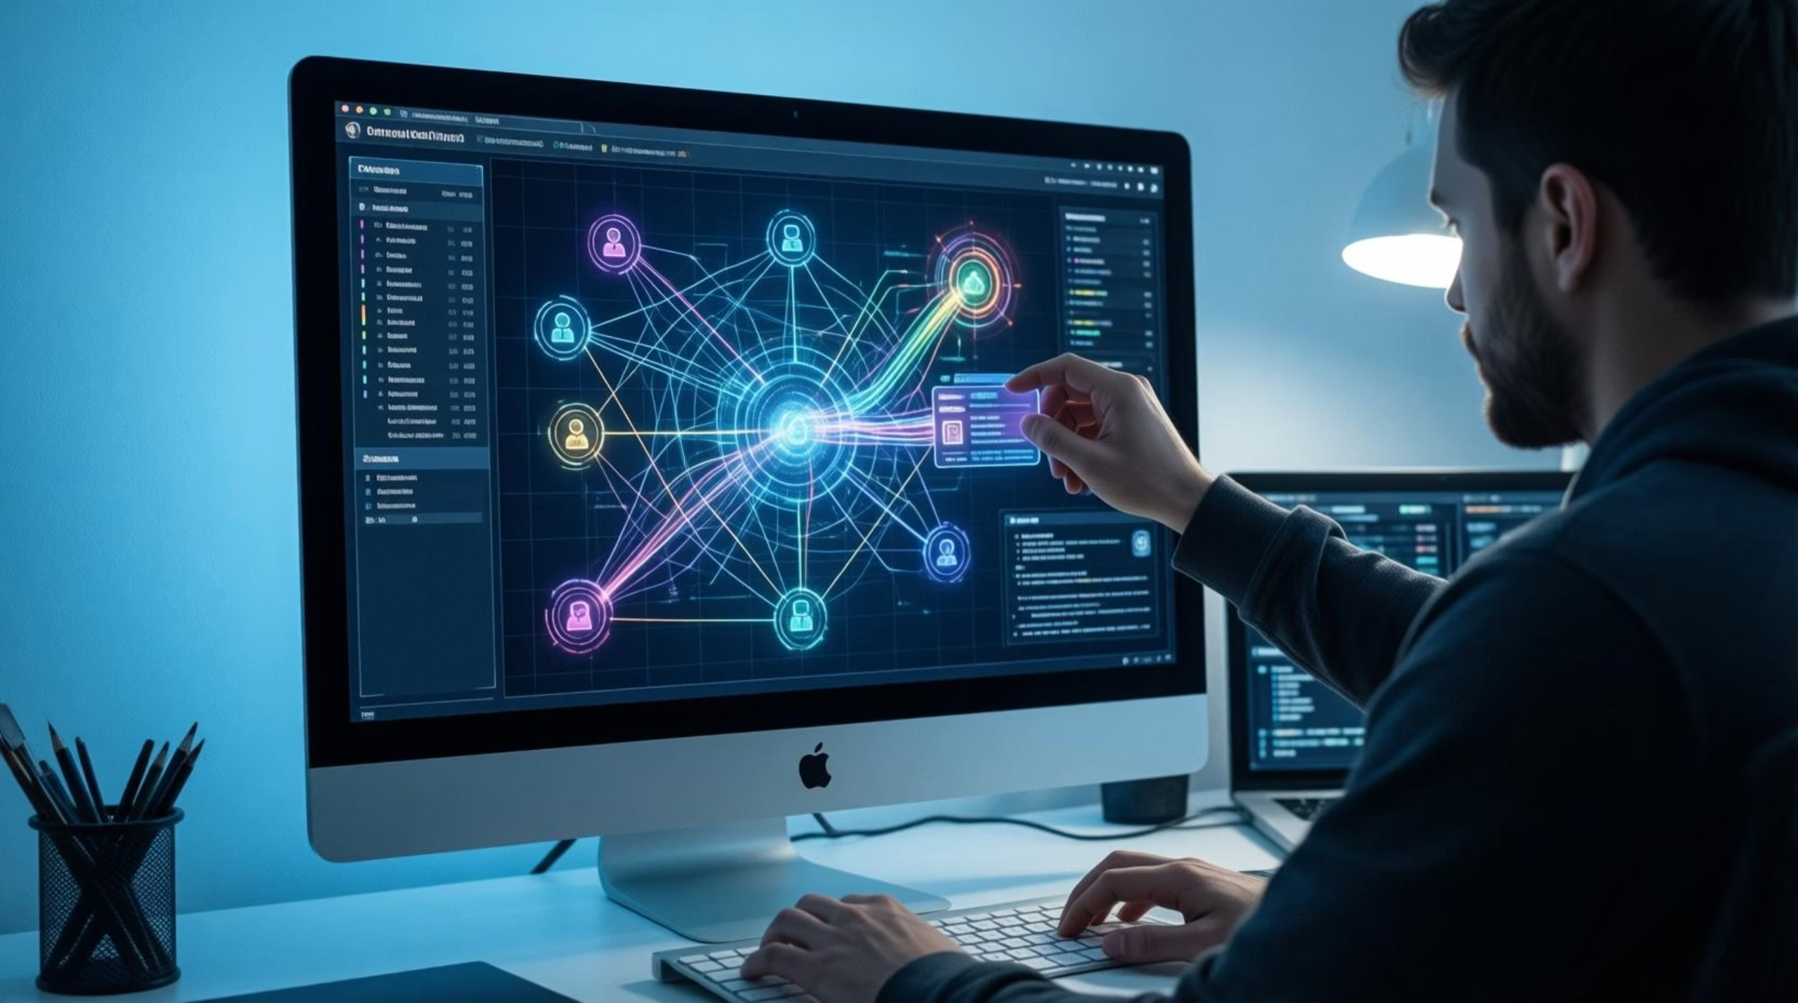





INTRODUCTION
Context: The rapid growth of digital platforms has led to a surge in identity theft, making it a top-tier cybersecurity threat.
The Vulnerability: Traditional security (Passwords, OTPs) is static. Once credentials are stolen via phishing or malware, systems cannot distinguish between the owner and an attacker.
The Solution: Moving beyond "one-time" login security toward "continuous" authentication. This system monitors how a user interacts with the application, not just what credentials they provide.

Slide 4


Existing System
Current Mechanism: Relies on single-point verification (Passwords, CAPTCHA, or OTP).
Limitations:
No monitoring after the initial login.
Vulnerable to session hijacking and credential theft.
Lacks the ability to detect human-specific nuances like typing rhythm or movement patterns.

Slide 5





Our Proposed Solution
Overview: An advanced security layer that uses behavioral profiling to verify identity throughout the session.
Login
Username, password, OTP verification
Behavioral Profiling
Analyze typing, mouse, device patterns
Continuous Monitoring
Real-time threat detection throughout session
Instant Response
Alert, verify, or block suspicious activity

Slide 6







Behavioral Profiling Parameters
The system creates a "Digital Signature" for users based on:
Keystroke Dynamics: Timing and rhythm of typing.
Interaction Patterns: Mouse clicks and movement trajectories.
Environmental Data: IP address, geo-location, and device/browser specifics.
Temporal Habits: Common login times and navigation routes.

Slide 7






System Modules
1.User Registration & Authentication Module
Enables secure user registration and login.
Integrates OTP/CAPTCHA for enhanced security.
2.Behavioral Analysis & Profile Management Module
Collects user behavioral data such as typing speed, keystroke patterns, login time,
IP address, device, browser and location.
Creates and maintains individual user behavioral profiles.
3.Identity Theft Detection Module
• Compares real-time behavior with stored profiles.
• Identifies abnormal or suspicious activities.
4.Alert & Response Module
• Sends alerts for suspicious behavior.
• Triggers OTP re-verification or session termination.
5.Admin Module
• Displays suspicious login and activity reports.
• Allows admin to manage users and accounts.

Slide 8






Project Objectives
Develop a secure C# ASP.NET Web Forms-based system.
Maintain individual behavioral profiles for all registered users.
Detect and prevent unauthorized access in real time, even post-login.
Generate alerts and provide an administrative module for security r

Slide 9


Technical Specifications
Hardware Requirements
Software Stack
OS: Windows 11, 64-bit
Language: C# (.NET Core 7.0+)
Processor
Hard Disk
Intel Core i3 or higher
500 GB SSD or higher
Frontend: HTML5, CSS, JavaScript, Angular 16+
Backend: ASP.NET Core, .NET Core
Memory
Database: SQL Server 2019 / MySQL 8.0
IDE: Visual Studio 2022, Visual Studio Code
8 GB RAM or more
AI/ML: Python 3.11+,
TensorFlow/PyTorch

Slide 10




THANK YOU

